Slide 1


Software Development Internship at Amazon
Pratit Vithalani
Faculty Advisor: Dr. Yusuf Pisan

Slide 2

About My Team
Organization: Amazon.com
Customer Trust and Partner Support
Team works on analyzing sellers and detecting fraudulent behavior
Clients: Machine Learning Scientists

Slide 3
My Project
Addition and redesign of internal web tool
Add another team’s APIs to give more information to clients
Make the overall web page look better
Interview clients to get input on changes they want

Slide 4
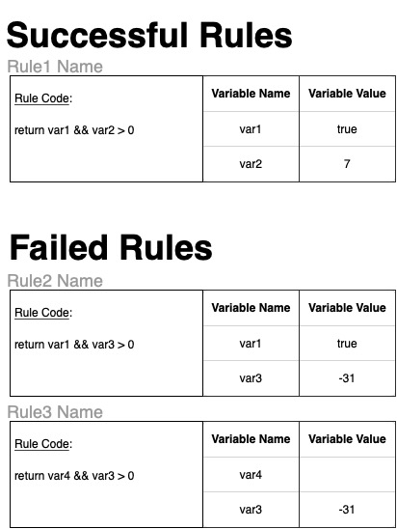
Design of New Section
Adding section that is integrated with another team’s APIs
Created wireframe for putting information onto existing web tool

Slide 5
Interviewing Clients
Asked team to understand who our clients are
Scheduled and conducted meetings with seven clients
Interview Questions
When would you use my team’s web tool?
How do you utilize my team’s web tool? (Walk-through of their day-to-day interaction)
What are limitations to the web tool?
What improvements can be made to make your job easier?

Slide 6



Implementation of Updates
Used Java to make the API calls
Used JSP to get the information from the Java backend to be displayed to the web page
Used HTML, CSS, JavaScript, and Bootstrap elements to improve the overall look and feel

Slide 7



Tools & Languages
Tools: IntelliJ, AWS, Bootstrap
Languages: Java, JSP, HTML, CSS, JavaScript, Python
Other Amazon internal tools

Slide 8
Challenges
Getting adjusted to Amazon’s internal tools
Getting other team’s API set up
Needed to get them to approve API usage
Many people on the other team didn’t know about the APIs I wanted to use
The people who did know about the APIs wanted to be convinced that they should let me use them

Slide 9
Key Takeaways
Learned web programming
Experienced how Amazon and my team do meetings
First 20 minutes reading document, rest of the time discussing
Keep pushing to get your questions answered
At times, people get busy with other tasks, so a friendly reminder to get back to your task is needed
Know when to escalate to manager

Slide 10
Related Courses
Before Internship | After Internship
CSS 142/3 – Computer Programming | CSS 436 – Cloud Computing
CSS 301 – Technical Writing | CSS 478 – Usability & User Centered Design
CSS 342/3 – Data Structures & Algorithms | CSS 481 – Web Programming & Applications
CSS 360 – Software Engineering
CSS 370 – Analysis & Design
CSS 475 – Database Systems

Slide 11
Thank you
Thanks to my manager, Hannes Scheidler, for giving me the opportunity to intern and showcase my skills
Thanks to my mentor, Yingzhu Deng, for helping guiding me through the internship process and helping me get adjusted to the Amazon internal tools
Thanks to my faculty advisor, Dr. Yusuf Pisan, for your advice during and after my internship

Slide 12

Any Questions?

